Slide 1
SMP
Because we like our TLAs

Slide 2

In the quest to go faster:
We increased CPU clock frequency. The theoretical max is ~10Ghz…
We found better algorithms/implementations for instructions that used to be really expensive (multiplication/division)
We pipelined the CPU to allow #1, but also to allow #4
We went superscalar – multiple integer and float units
We improved caches and moved them onto the CPU’s silicon
We widened the path to memory and increased memory speed
We split hard instructions into microinstructions inside the CPU
Register renaming reduces work (R->R move) and allows speculative execution.
Branch prediction helps us keep our pipeline full.
And it’s still not enough. What more can we do?

Slide 3
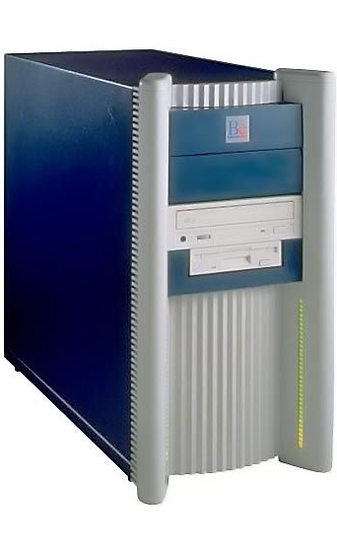
Symmetric Multiprocessing
From the 60’s, mainframes would often have multiple CPUs.
That slowly trickled down to desktop PCs.
1995 saw the release of the BeBox (PowerPC)
On the Macintosh, 1997 saw the first dual processor (PowerPC) machine.
The Pentium Pro (1995-1998) and AthlonMP (2001-2005) were both aimed at servers.
On the x86/x64, we still don’t see multiple CPUs in a typical (non-server) motherboard, although there have been a few…

Slide 4
Why?
Why did this (seemingly) obvious optimization not happen sooner?
Up until 1990 or so, people mostly ran DOS – a single application OS
There was a LOT of room to grow with clock speed
CPUs were really expensive. Who could AFFORD two?
Memory was expensive. Who has enough to run 2 or more apps?
How could you run 2 apps? You put in a floppy for 1 app, then ???
SMP is hard

Slide 5
First Approaches
Since CPU makers already made CPUs and memory access went through a Northbridge chip, the obvious approach was to put another socket on the motherboard.
Either switch CPUs access to the Northbridge OR create a Northbridge that could accept control signals from two different CPUs (better)
Problem?

Slide 6
Cache Coherency
Both CPUs would have cache onboard. How do we ensure that we don’t end up with outdated data still in cache?
It’s a MESI problem (Modified, Exclusive, Shared, Invalid)
Add 2 bits to each cache entry, indicating one of the above 4 states
Each processor snoops the other’s memory accesses and invalidates cache entries it holds that the other has written
Also stall reads when another cache has a modified value

Slide 7
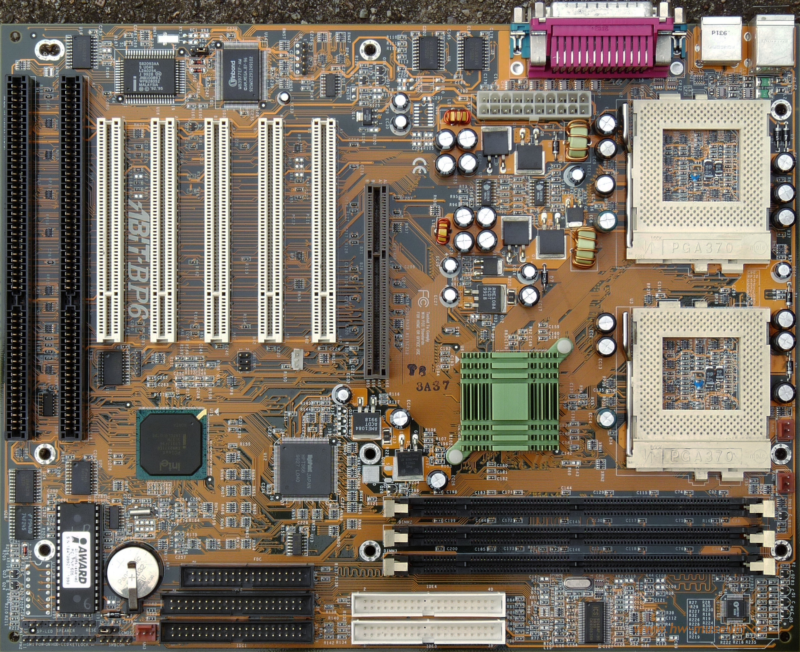
Timing Issues
With the CPUs physically distinct, there is a limit to how fast signals can transfer between the two
Plus, half of the motherboard is taken up by CPUs, Northbridge and signal lines

Slide 8
Multiple Cores
Multiple cores have a number of advantages over dual CPU
Cheaper to make (one package)
Easier to make a motherboard for
More integration (shared L3 cache, cache coherence on die, same clock)
Disadvantage
Only one package to dissipate heat over

Slide 9
HyperTransport
When chips need to talk to other chips, they need a set of rules to follow. Intel uses “Front Side Bus”. AMD uses HyperTransport, an open standard.
HyperTransport is a packet based, high bandwidth and low latency point to point protocol. Think of it like a wired network.
It can handle multi-processor cache coherency, interfacing to expansion slots, memory, more…

Slide 10
HyperTransport Legacy
HT was a great technology for connecting a low number of subsystems together.
As a point to point system, though, it doesn’t scale well beyond a certain number of systems.

Slide 11
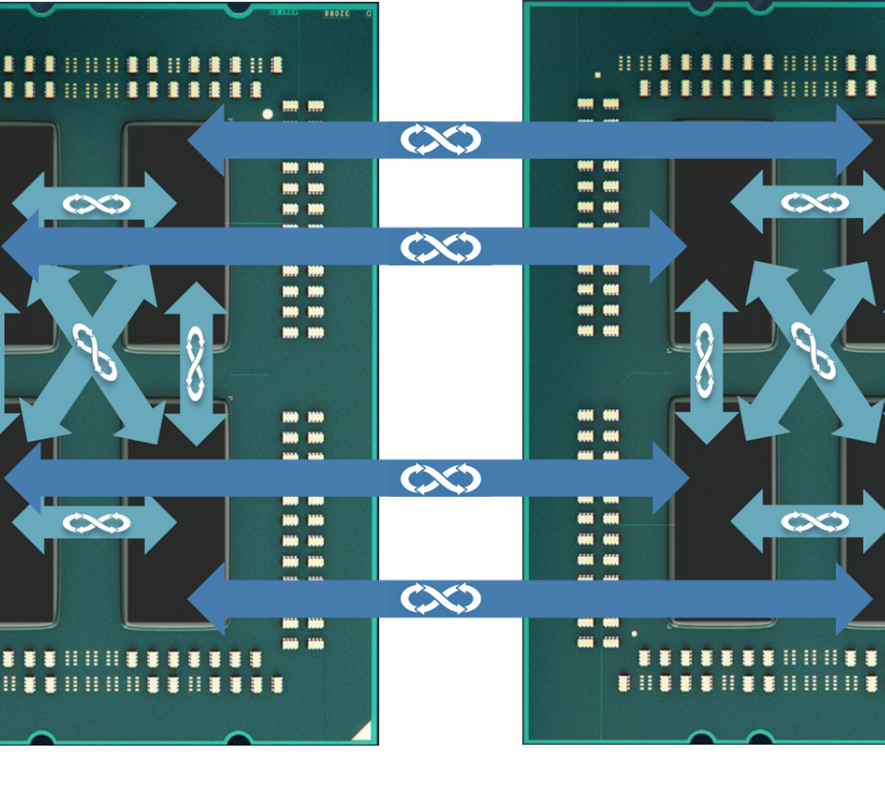
Infinity Fabric
Uses a mesh instead of point to point
Monitors temperatures across cores and can boost performance if temperatures are low
Connects L3 cache, cores and RAM
IF runs are the same speed as RAM

Slide 12
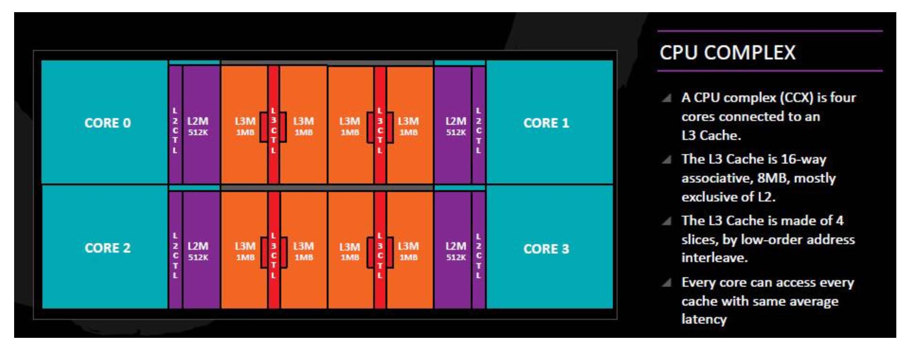
What’s a Core?
A core is an (almost) complete CPU.
What’s missing? L3, memory controller

Slide 13
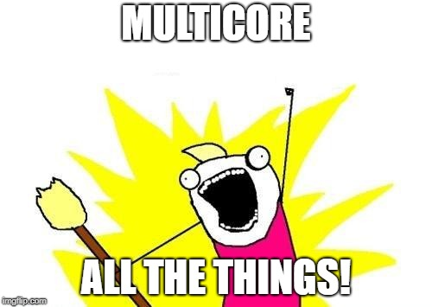
Why not have dozens or hundreds of cores?
Cache coherency gets harder
Multithreading applications is hard
More cores means more heat
Memory can’t keep up
Run out of room on the silicon

Slide 14
SMP == Symmetric Multiprocessing
The “S”, Symmetric, is a key word.
In an SMP system, all cores/processors are equal. They have equal access to memory, to each other, and to peripherals.
Let’s consider a few items from the previous slide:
Cache coherency gets harder
Memory can’t keep up

Slide 15
How could we fix those items?
What if the caches didn’t need to be coherent?
What if each CPU had its own memory?
If that was the case, we could put the CPUs further apart (separate dies), reducing the heat and space issues, too.

Slide 16
That only leaves one issue!
Multithreading applications is hard
If it is hard to create applications where you can easily share data (since it is all shared), how much harder is it to create multithreaded applications if you CAN’T share data easily?

Slide 17
NUMA
Non-Uniform Memory Architecture – all CPUs don’t have the same access to memory.
Generally, they DO share memory, but the access speed differs – each CPU has local memory but also can use a shared network to get to the other memory (paying a performance penalty).
Another name for this is “distributed system memory” or DSM.

Slide 18
PlayStation 3
For the follow up to the massively popular PS2, Sony chose a very different approach for the PS3.
To get the “next generation” power to make the PS3 far better than the competition, SONY tried a NUMA approach.
They worked with IBM and Toshiba to build a system architecture of many smaller processors.

Slide 19
256KB RAM
Power Processing Element
(Power PC)
SPE
128 Registers
SPE
SIMD CPU
SPE
SPE
Interconnect Bus (96 bytes/cycle)
SPE
SPE
External Memory 256mb
1 SPE is dedicated to security/operations
1 SPE is disabled to increase chip yield
SPE
SPE
External I/O

Slide 20
How much did developers love it?
The [SPEs] had huge potential, but huge effort was required to program them
During that phase, everybody was obsessed with the Cell architecture of the PlayStation 3, and that was really quite a tough thing for people to get hold of. However, if you were able to do it, your games could really go the extra mile—if you could actually crack how to use that Cell architecture.

Slide 21
Sony might have been early
PS3 was the first introduction of NUMA to a lot of game developers.
NUMA is becoming more popular. AMD Server processors (Opteron and EPYC) have been NUMA for many years. Some of the new (2018) Ryzen CPUs are NUMA as well.
Part of Sony’s design issue was that the penalty for crossing CPU boundaries was too high AND the SPEs were a different instruction set than the main processor. AMD doesn’t do that; the only difference with these designs is the cost of access of memory.

Slide 22
AMD found that creating a NUMA design made their design possible and reasonably priced. Each of the four clusters of cores has (fastest/direct) access to one memory channel and access via Infinity Fabric to the other memory channels.

Slide 23
Affinity
The operating system, in the process of scheduling processes, needs to take the underlying architecture into account to get the most system performance possible.
Mostly this requires tuning a set of parameters – defining the cost of migrating a thread from one core to another. After that, the scheduling algorithm does the calculations. These parameters define affinity – how much a thread “likes” staying on the same core.

Slide 24
SMP/NUMA conclusion
We started with single CPUs.
We moved to multiple CPUs, then multiple cores with SMP.
We are starting to move toward NUMA, out of necessity (memory bandwidth and latency).
Programming multiple processors is hard.

